Slide 1
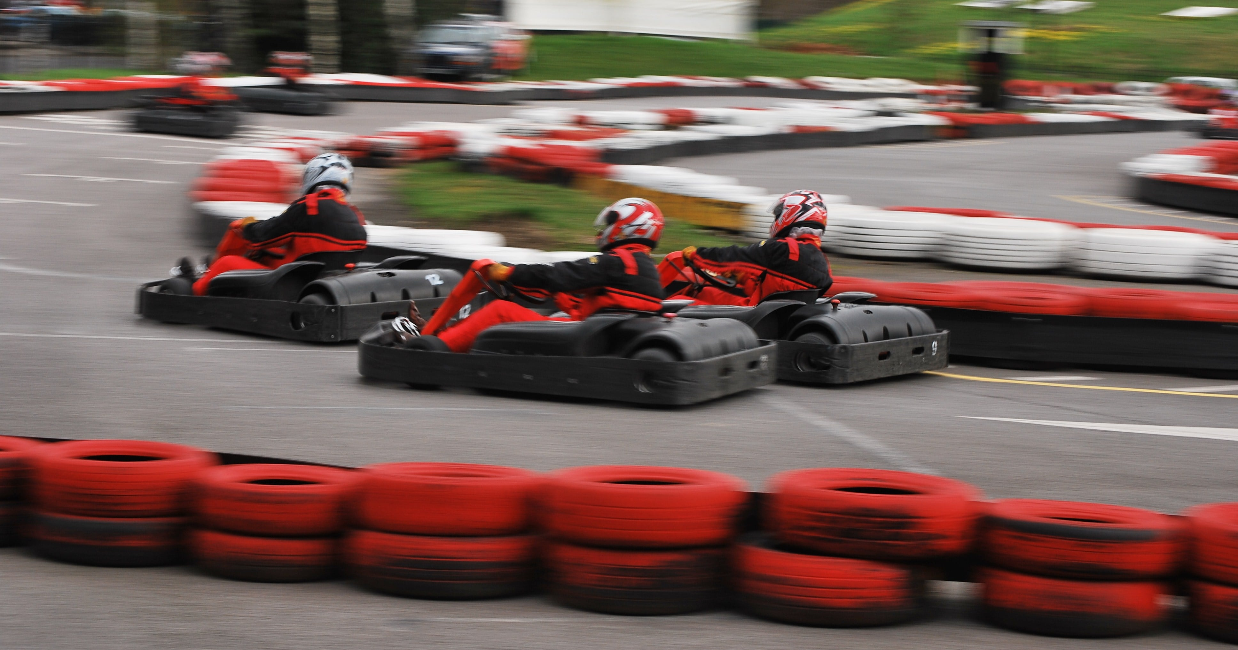


Virtual Reality GO-KARTING
Group - 4
COMP – 8117 ADVANCED SOFTWARE ENGINEERING PROJECT

Slide 2
Team Members
Lakshika Anand -110065893
Appala Vishnu - 110085072
Asireddy Karnakar Reddy - 110061867
Gavini Dheeraj - 110074707
Pagadala Kedareshwara Kartikeya Rao - 110083315
Sharma Sagar - 110072112
Sun Xiaomeng - 110069044
Vemula Pavansai - 110061751

Slide 3
Contents

Slide 4

Section 1 – Project Introduction

Slide 5
Customer Requirements
Innovative idea around metaverses and omniverses.
Game must include components allowing interactions with reality.
Require to create a team of max 8 members.
Budget around 3 million CAD.

Slide 6
Team Structure
Lakshika Anand - Scrum Master, Software Developer
Vishnu Appala - Software Developer, Tester
Kedareshwara Kartikeya Rao - Software Developer, Tester
Dheeraj Gavini - Software Developer, Tester
Karnakar Reddy Asireddy - Software Developer
Sagar Sharma - Software Developer
Xiaomeng Sun - Software Developer
Pavansai Vemula - Software Developer

Slide 7
Introduction

Slide 8
Main Features

Slide 9
Characteristics

Slide 10
Technologies

Slide 11
Justification for Technologies Used

Slide 12
Cost Analysis

Slide 13

Design

Slide 14
Use Case Diagram

Slide 15
Class Diagram

Slide 16
Sequence Diagram

Slide 17

Section 2 - Methodology

Slide 18
Lifecycle and Tools

Slide 19
Why?

Slide 20
Testing

Slide 21
Quality Management

Slide 22
Risk Management

Slide 23

Section 3 – Steps for Development

Slide 24
Sprint 1

Slide 25
Features

Slide 26
Gantt Chart

Slide 27
Analysis

Slide 28
Sprint 2

Slide 29
Features

Slide 30
Gantt Chart

Slide 31
Analysis

Slide 32
Sprint 3

Slide 33
Features

Slide 34
Gantt Chart

Slide 35
Analysis

Slide 36
Sprint 4

Slide 37
Features

Slide 38
Gantt Chart

Slide 39
Analysis

Slide 40

Game Demo

Slide 41

Future Additions

Slide 42
Conclusion

Slide 43

Thank You

Slide 44

Time For Questions!!!

